Slide 1
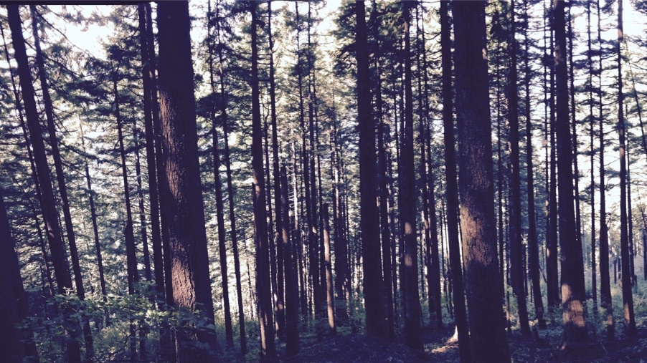
Using plant ecophysiological theory to derive mechanisms from large-scale datasets
Nick Smith
Texas Tech University
nick.smith@ttu.edu; @nick_greg_smith

Slide 2
Plant ecophysiologists now have access to a TON of data!
nick.smith@ttu.edu; @nick_greg_smith
#observations in TRY
>10 million trait observations in TRY alone
Kattge et al. (2020)

Slide 3
But what does one do with all these data?
nick.smith@ttu.edu; @nick_greg_smith

Slide 4
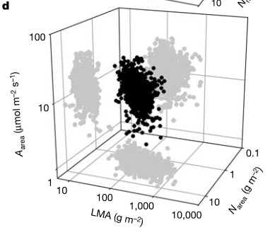
Assess variability and trade-offs in plant form and function with trait relationships
nick.smith@ttu.edu; @nick_greg_smith
Diaz et al. (2016)
Wright et al. (2004)

Slide 5
Problems with the traditional approach
nick.smith@ttu.edu; @nick_greg_smith
Hard to quantify
Results reveal patterns with lots of unexplained variation
Difficult to create a reliable, predictive framework
Scaling (up or down) is tricky
Projections under novel conditions based on empirical trends is unreliable

Slide 6
Solution: use a quantitative theory as a null model
nick.smith@ttu.edu; @nick_greg_smith

Slide 7
Example: photosynthetic least cost theory
nick.smith@ttu.edu; @nick_greg_smith

Slide 8
Least cost theory
nick.smith@ttu.edu; @nick_greg_smith
Maintain fastest rate of photosynthesis at the lowest cost (water and nutrient use)
Wright et al. (2003)

Slide 9
Optimal photosynthesis
nick.smith@ttu.edu; @nick_greg_smith
Photosynthesis = f{stomatal conductance,
photosynthetic biochemistry}

Slide 10
Optimal photosynthesis
nick.smith@ttu.edu; @nick_greg_smith
Photosynthesis = f{stomatal conductance,
photosynthetic biochemistry}
Least cost theory can predict optimal that maximize photosynthesis at the lowest resource cost

Slide 11
Optimal photosynthesis
nick.smith@ttu.edu; @nick_greg_smith
Photosynthesis = f{stomatal conductance,
photosynthetic biochemistry}
Contact me to discuss the math!

Slide 12
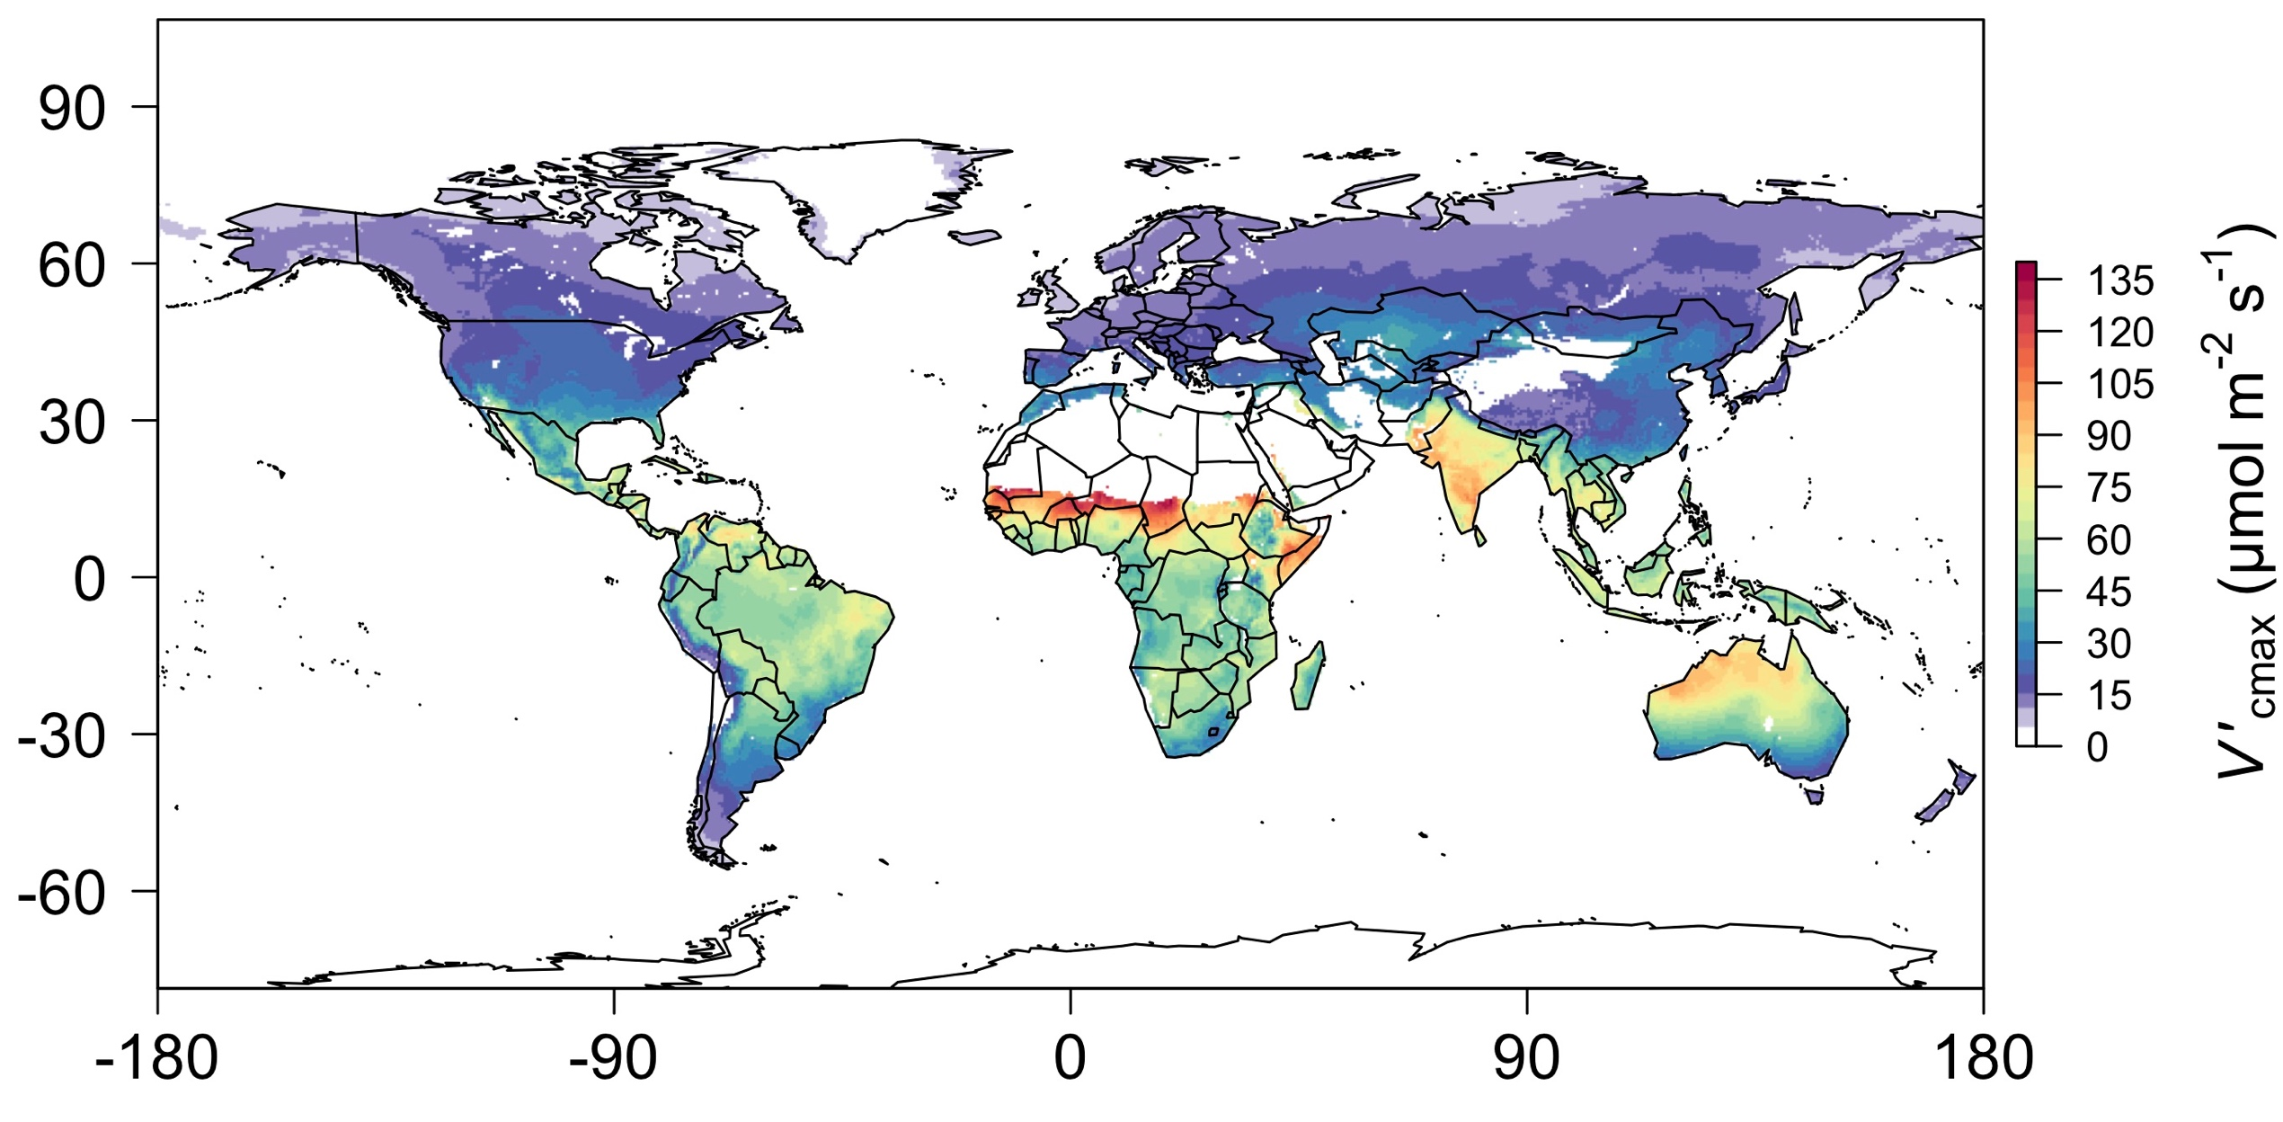
nick.smith@ttu.edu; @nick_greg_smith
Global, optimally acclimated traits!
Smith et al. (2019)

Slide 13
Different approach to data analysis
nick.smith@ttu.edu; @nick_greg_smith
Gather data
Make theoretical predictions of measured trait
Compare predictions with observations to either:
Confirm theory
Identify biases that would indicate poor understanding and necessitate further theory development and testing

Slide 14
Example insights from theory-data comparisons
nick.smith@ttu.edu; @nick_greg_smith

Slide 15
1. Is photosynthetic biochemistry is optimized to climate?
nick.smith@ttu.edu; @nick_greg_smith

Slide 16
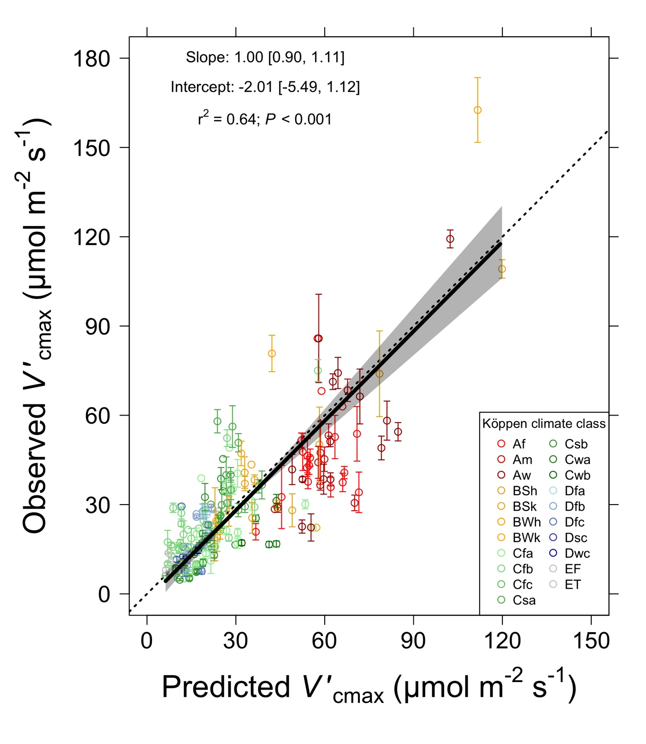
Is photosynthetic biochemistry is optimized to climate?
nick.smith@ttu.edu; @nick_greg_smith
V_{cmax} predicted from photosynthetic least cost (climate only) is similar to observed values
Smith et al. (2019)

Slide 17
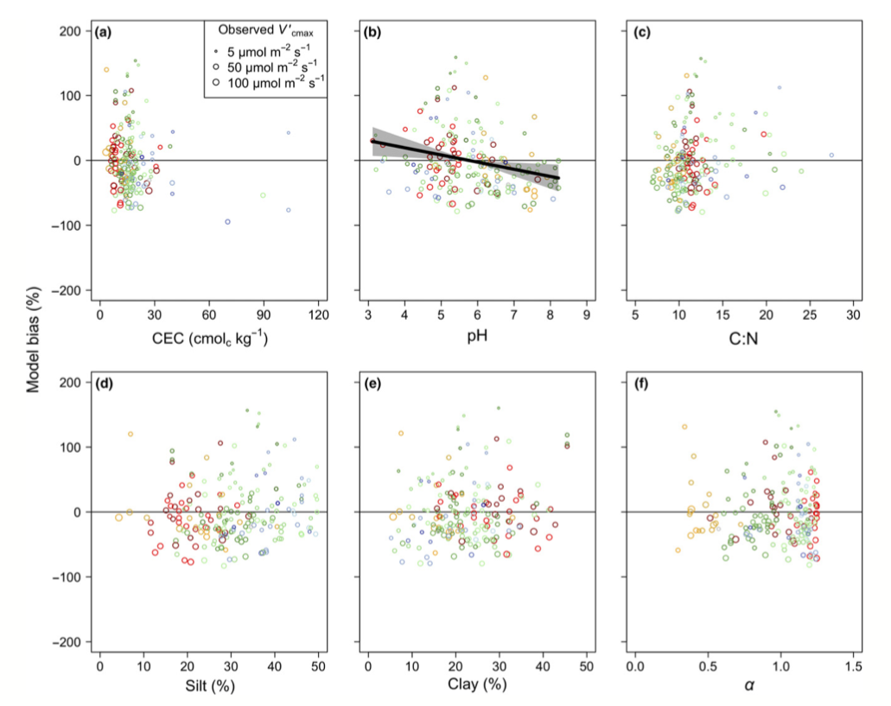
Is photosynthetic biochemistry is optimized to climate?
nick.smith@ttu.edu; @nick_greg_smith
Soil increased explained variation from 64% to 68% compared to climate response alone. A missing mechanism?!
Smith et al. (2019)

Slide 18
2. Is photosynthetic acclimation to CO₂ is the result of optimal downregulation?
nick.smith@ttu.edu; @nick_greg_smith

Slide 19
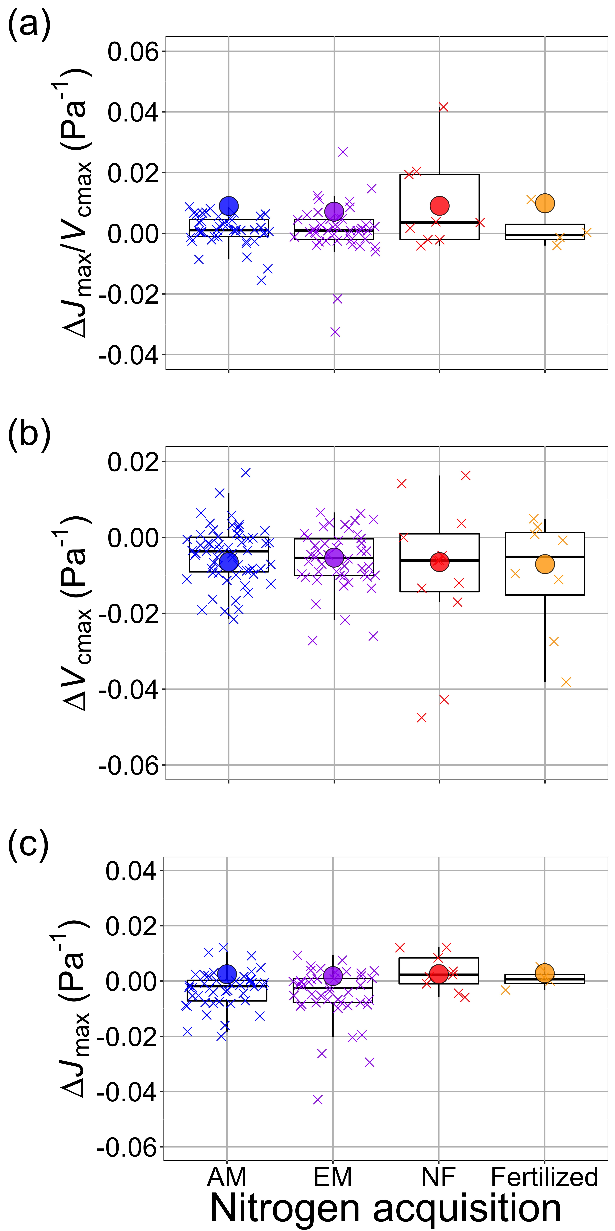
Is photosynthetic acclimation to CO₂ is the result of optimal downregulation?
nick.smith@ttu.edu; @nick_greg_smith
The observed change in V_{cmax} under elevated CO₂ (∆V_{cmax}; boxes and exes) is similar to that predicted by theory (dots), regardless of fertilization or symbiotic association
Smith & Keenan (2020)

Slide 20
Is photosynthetic acclimation to CO₂ is the result of optimal downregulation?
nick.smith@ttu.edu; @nick_greg_smith
The fit is not nearly as good for J_{max}. This implies we are missing something important in our theory/understanding!
Smith & Keenan (2020)

Slide 21
3. Does increased O₂ specificity drive shifts in photosynthetic investment to Rubisco under warming?
nick.smith@ttu.edu; @nick_greg_smith

Slide 22
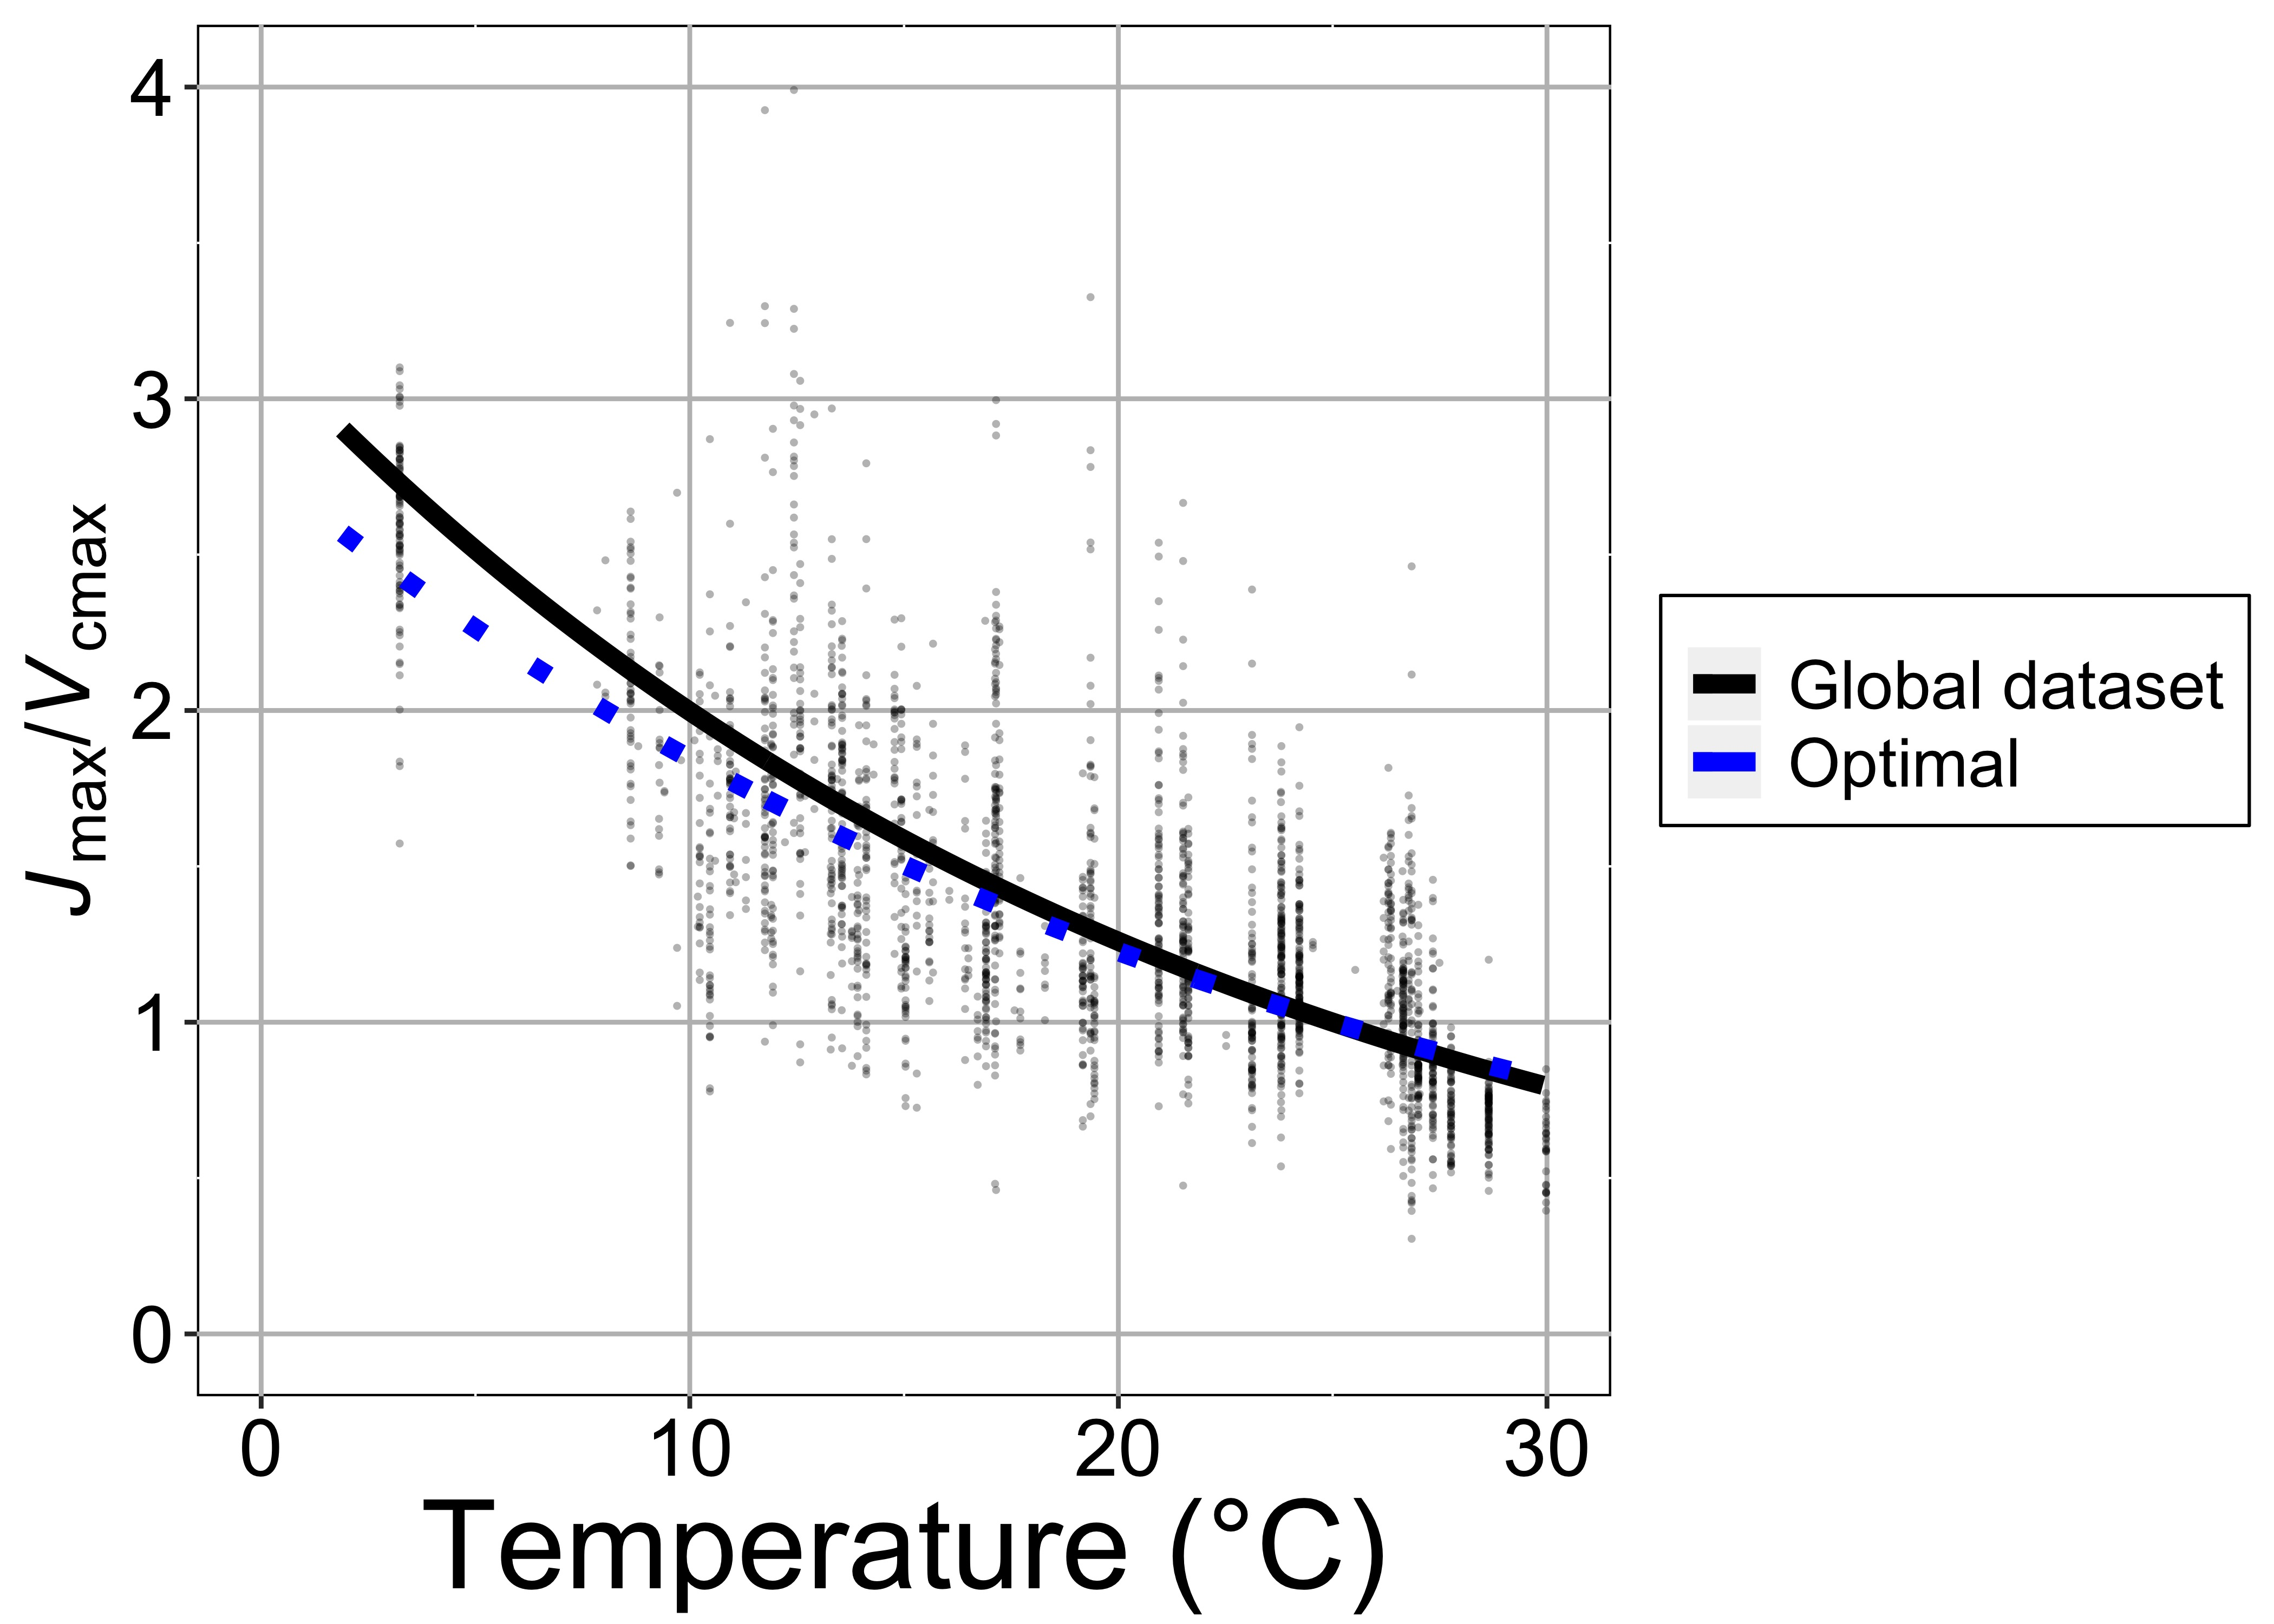
Does increased O₂ specificity drive shifts in photosynthetic investment to Rubisco under warming?
nick.smith@ttu.edu; @nick_greg_smith
Plants invest more in Rubisco carboxylation (V_{cmax}) relative to electron transport (J_{max}) as temperatures increase (black line), as expected from theory (blue line), indicating that this is due to the increase in Rubisco O₂ specificity as temperatures warm
Smith & Keenan (2020)

Slide 23
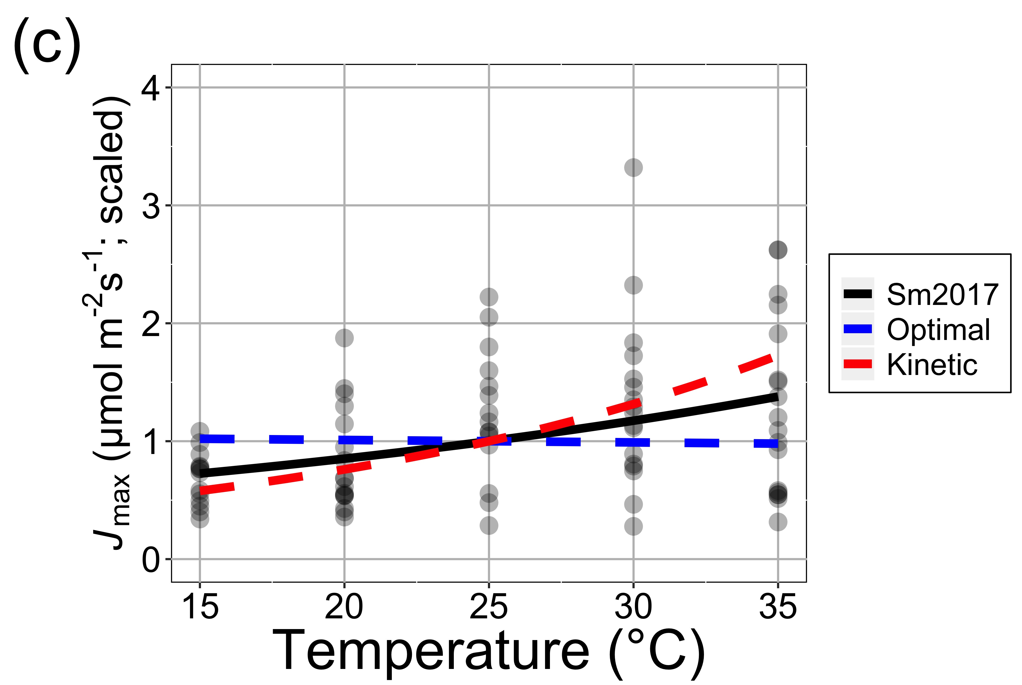
Does increased O₂ specificity drive shifts in photosynthetic investment to Rubisco under warming?
nick.smith@ttu.edu; @nick_greg_smith
J_{max} sensitivity alone is poorly predicted (compare black observed and blue modeled lines). Maybe our understanding of electron transport is limited compared to carboxylation?
Smith & Keenan (2020)

Slide 24
4. Can differences in optimal photosynthesis explain patterns in C₃/C₄ abundance?
nick.smith@ttu.edu; @nick_greg_smith

Slide 25
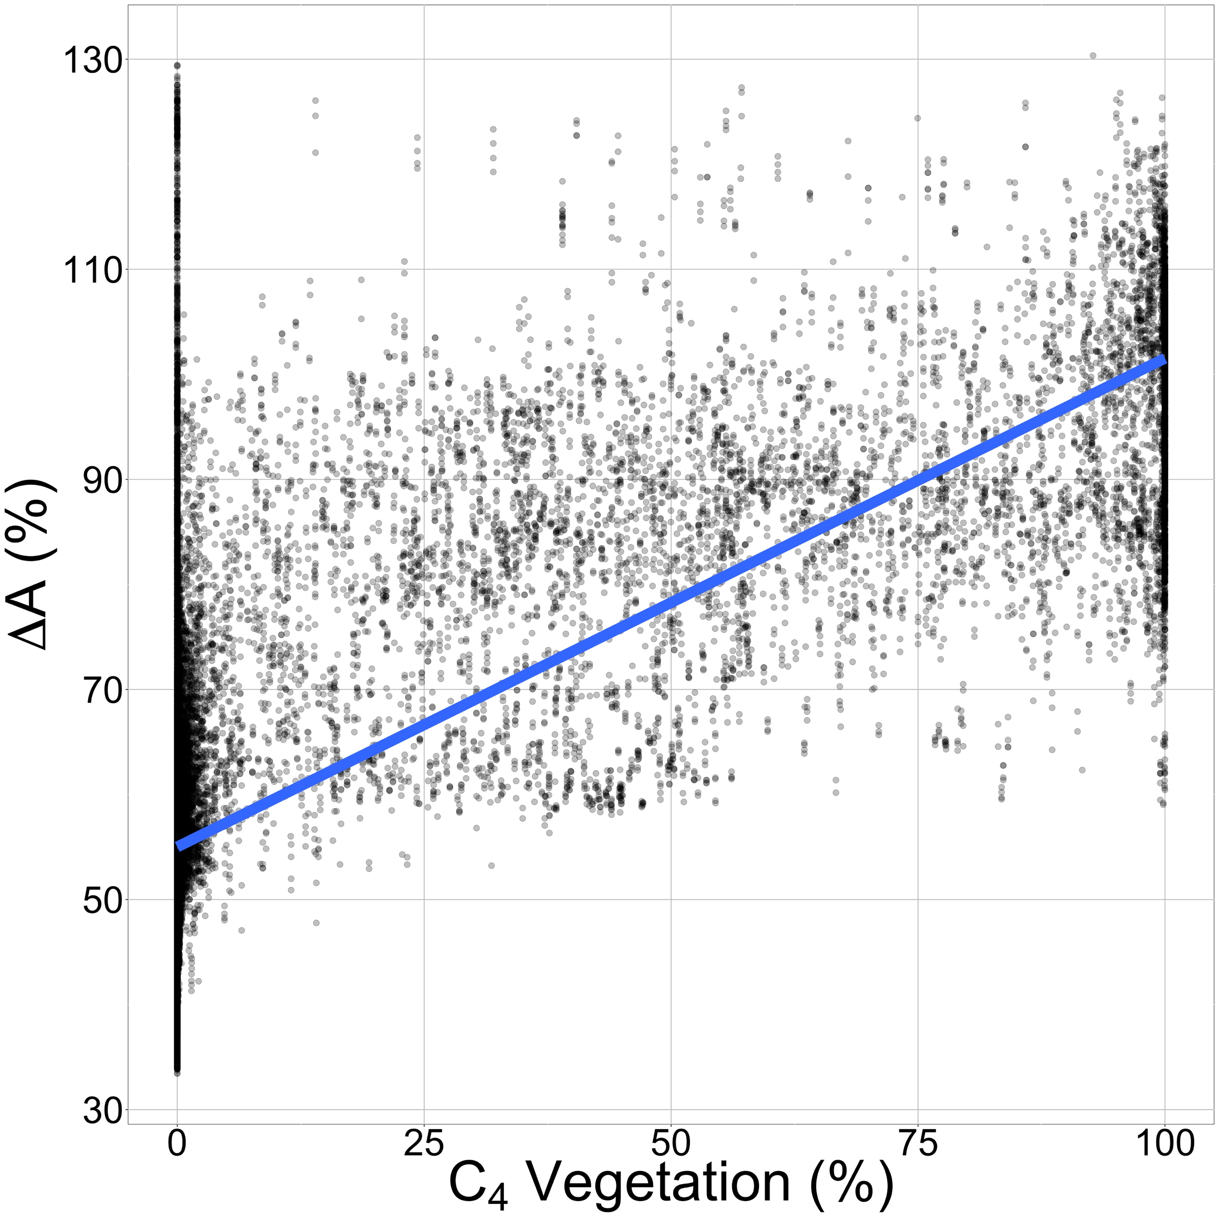
Can differences in optimal photosynthesis explain patterns in C₃/C₄ abundance?
nick.smith@ttu.edu; @nick_greg_smith
The relative advantage of optimal C₄ photosynthesis in 1° gridcells across the globe (y-axis) scales well with the observed amount of C₄ vegetation in those gridcells (x-axis) (r²=0.56; P < 0.001)
Scott & Smith (in prep)

Slide 26
Can differences in optimal photosynthesis explain patterns in C₃/C₄ abundance?
nick.smith@ttu.edu; @nick_greg_smith
This is a model-model comparison, necessary because few relevant data exist. Could be used to argue for funding to gather more data!
Scott & Smith (in prep)

Slide 27
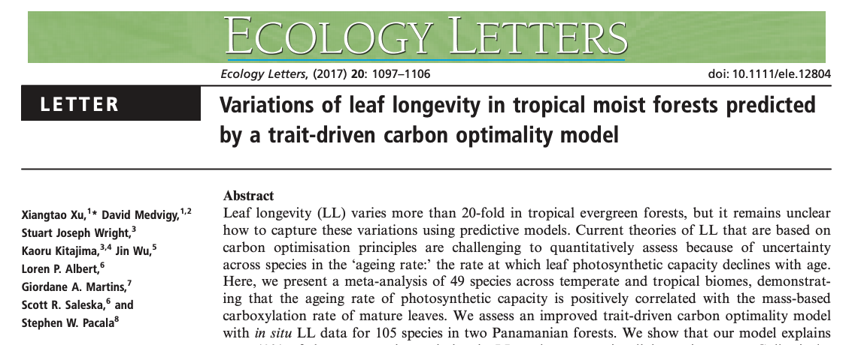
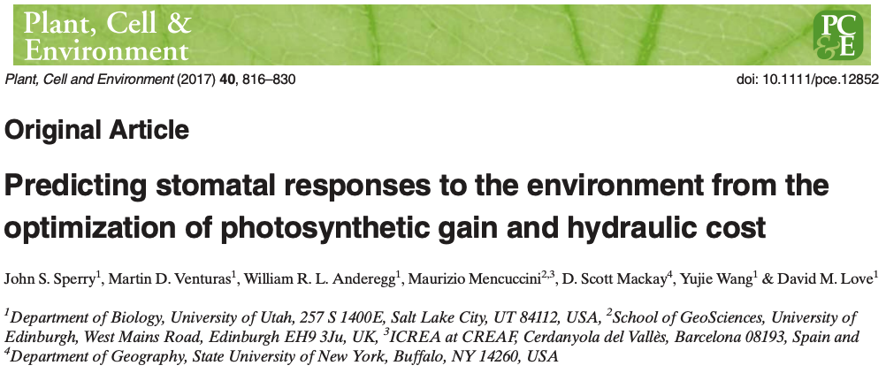
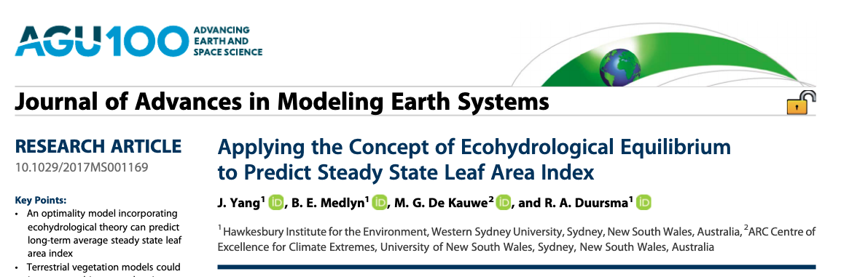
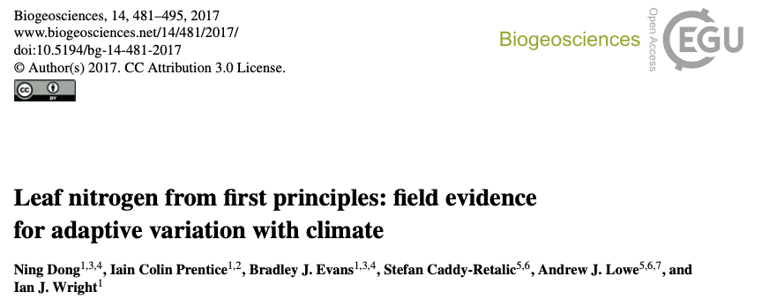
Theoretical models exist for a number of other ecophysiological traits and processes!
nick.smith@ttu.edu; @nick_greg_smith

Slide 28
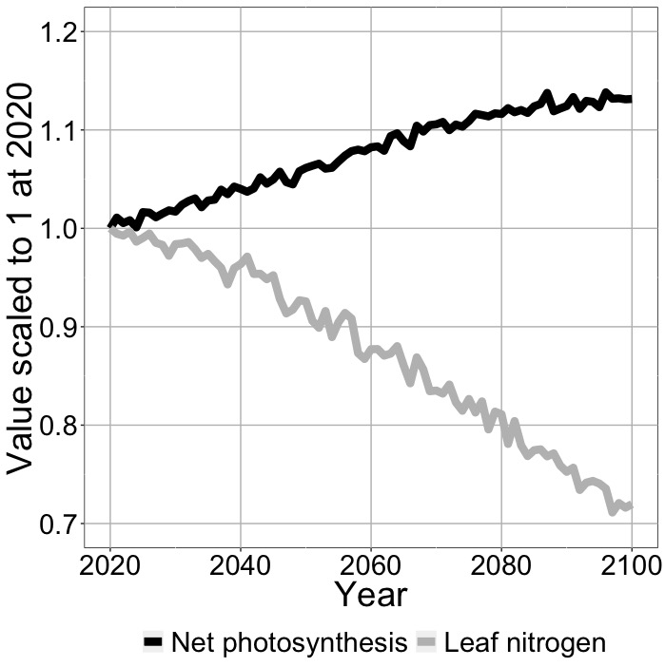
Conclusions
nick.smith@ttu.edu; @nick_greg_smith
Quantified theory can be invaluable for:
Testing mechanisms with large-scale data
Identifying knowledge gaps
Makes post analysis model incorporation much easier
Example land surface model simulation with incorporated photosynthetic least cost theory
Smith et al. (in prep)

Slide 29
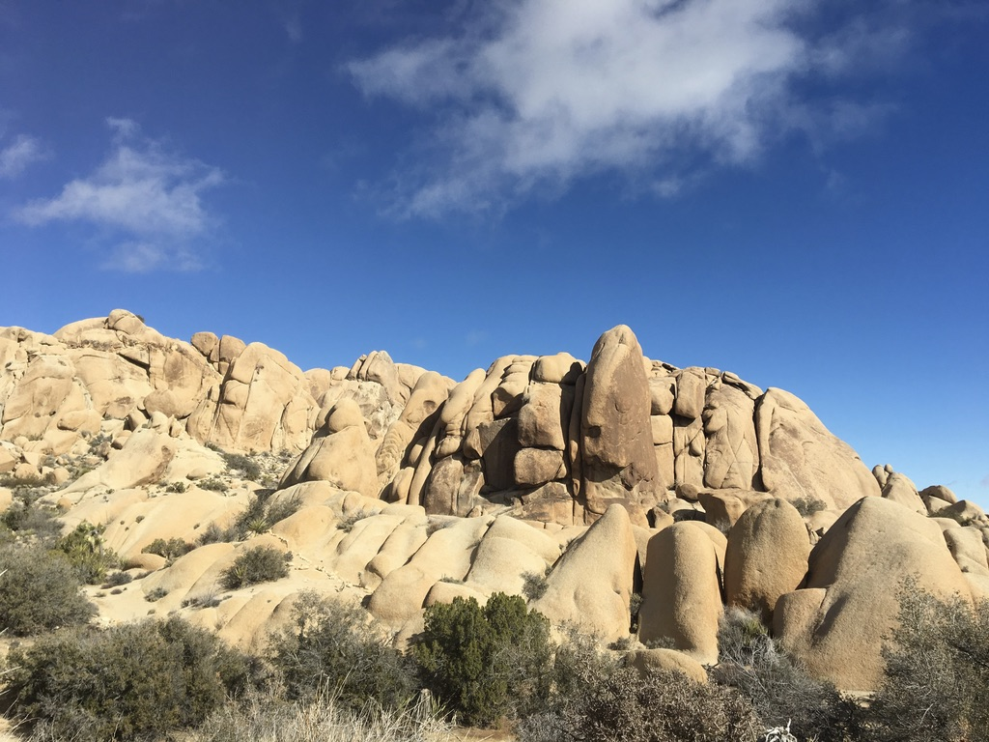
nick.smith@ttu.edu; @nick_greg_smith
Presentation available at:
www.github.com/SmithEcophysLab/ESA_2020
Thanks!

